Slide 1
DB2 for the COBOL Programmer

Slide 2
DB2 – Module 1
DB2 Key concepts and Normalization

Slide 3
Learning Objective
By the end of this module, the participants
will be able to
  Define Database Management Systems
  List the advantages of DBMS
  Explain how a relational database model is organized
  Explain how tables in relational database are related
  Define Normalization

Slide 4
Learning Objective Contd…
  List various types of Normalization
  Introduction to SQL
  Use SQL with DB2 Database
  State the different languages used in DBMS
  List the DDL statements and DML statements
  Describe Tables Spaces, Index, synonym, Alias and Views

Slide 5
Database Management System (DBMS)
Stores information in electromagnetic form
Makes information available for sharing by users or programs
Notes:
What is DBMS? A collection of programs that enables you to store, modify, and extract information from a database. There are many different types of DBMSs, ranging from small systems that run on personal computers to huge systems that run on mainframes. The following are examples of database applications:
computerized library systems
automated teller machines
flight reservation systems
computerized parts inventory systems
From a technical standpoint, DBMSs can differ widely. The terms relational, network, flat, and hierarchical all refer to the way a DBMS organizes information internally.
What is program? An organized list of instructions that, when executed, causes the computer to behave in a predetermined manner. Without programs, computers are useless. A program is like a recipe. It contains a list of ingredients (called variables) and a list of directions (called statements) that tell the computer what to do with the variables. The variables can represent numeric data, text, or graphical images.
What is Database? - A collection of information organized in such a way that a computer program can quickly select desired pieces of data. You can think of a database as an electronic filing system A collection of information organized in such a way that a computer program can quickly select desired pieces of data. You can think of a database as an electronic filing system. Traditional databases are organized by fields, records, and files. A field is a single piece of information; a record is one complete set of fields; and a file is a collection of records. For example, a telephone book is analogous to a file. It contains a list of records, each of which consists of three fields: name, address, and telephone number

Slide 6
Advantages of DBMS
Provides facilities to developers to define data to the system
Provides facilities to users or programs to retrieve or change the data
Provides facilities for security and recovery
Maintaining the information consistency throughout the database

Slide 7
DB2 – Relational Database Model
In 1970, Dr E.F.Codd developed a new type of model for representation of data called a relational model
DB2 or Database 2 , is a relational database management system (RDBMS)
Runs on IBM mainframe computers, AS/400 mid-range computers and PC’s

Slide 8
Organization of DB2 Table
Relational database uses tables to store and manipulate data
Each table has one or more rows or records
Each row contains one or more columns or fields
The data in a specific column of a specific row can be referred to as a value
Notes:
What is a Relational Database? A relational database stores all its data inside tables, and nothing more. All operations on data are done on the tables themselves or produces another tables as the result. You never see anything except for tables
A table is a set of rows and columns. This is very important, because a set does not have any predefined sort order for its elements. Each row is a set of columns with only one value for each. All rows from the same table have the same set of columns, although some columns may have NULL values, i.e. the values for that rows was not initialized. Note that a NULL value for a string column is different from an empty string. You should think about a NULL value as an "unknown" value.
The rows from a relational table is analogous to a record, and the columns to a field. Here's an example of a table and the SQL statement that creates the table:
CREATE TABLE ADDR_BOOK ( NAME char(30), COMPANY char(20), E_MAIL char (25) )
There are two basic operations you can perform on a relational table. The first one is retrieving a subset of its columns. The second is retrieving a subset of its rows. Here are samples of the two operations:
SELECT NAME, E_MAIL FROM ADDR_BOOK
SELECT * FROM ADDR_BOOK WHERE COMPANY = 'EDM2'

Slide 9
Organization of DB2 Table Contd…
Tables may also contain a primary key that uniquely identifies each row in the table
An index can be applied to any column in a table
Notes:
A primary key is a minimal key specified as being primary. A table cannot have more than one set of attributes specified as the primary key, and the columns of a primary key cannot contain null values. In DB2 primary keys must be specified as being not null (see below). Primary keys are optional and can be defined in CREATE TABLE or ALTER TABLE statements.
PRIMARY KEY columns have the unique index (unqiue indexes wont allow duplicate values) defined on them, so that processing time of SQL will be very less compare than the non-index columns.
Primary key constraints forbid duplicate values in one or more columns of a table. A table cannot have more than one primary key, but it can have several unique keys. Primary key may consists of more than one column, it is then called composite key.
e.g. primary key:
CREATE TABLE employee (employee id PRIMARY KEY, employee name varchar(30) )
e.g. Composite key:
CREATE TABLE casting (movieid INTEGER, actorid INTEGER, PRIMARY KEY (movieid, actorid) )
Index: You can create indexes on DB2 table columns to speed up query processing. An index uses pointers to actual data to more efficiently access specific pieces of data. Once created, DB2 automatically maintains each index as data is added, modified, and deleted from the table. As data is selected from the table DB2 can choose to use the index to access the data more efficiently. It is important to remember that index modification and usage is automatic – that is, you do not need to tell DB2 to modify indexes as data changes nor can you tell DB2 to use a particular index to access data. This automation and separation makes it easy to deploy DB2 indexes
#1 --> SELECT * FROM REPORTS WHERE CUSTOMER_ID = 'blah' #2 --> SELECT * FROM REPORTS WHERE USER_ID = 'blah' #3 --> SELECT * FROM REPORTS WHERE CUSTOMER_ID = 'blah' and USER_ID = 'blah'
As you can see, if I create an index for #3 to both the CUSTOMER_ID and USER_ID for quicker response.
The question is do I have to make a sperate index for #1 and #2. (For #1 --> create index for CUSTOMER_ID and a seperate index for USER_ID while the #3 use a seperate index). Or would the #1 and/or #2 still work quickly by taking advantage of the index that was made for #3?? (Yea, may be a bit slower but faster than the one without an index).
solution
Index1: CUSTOMER_ID, USER_ID
Index2: USER_ID
Selects #1 and #3 would use the first index.
Select #2 would use the second index
Foreign key
A foreign key is a field in a relational table that matches the primary key column of another table. The foreign key can be used to cross-reference tables.
Through this key we can establish a relation between two tables. If table B foreign key refers table A's primary key, DB2 / ORACLE wont allow to enter the records into table B if the foreign key value in the input data is not present in the table A's primary key list of values

Slide 10
Organization of DB2 Table
The relationship between a customer table and an invoice table :-
CUSTNO FNAME LNAME ADDR CITY STATE ZIPCODE
400001 KEITH JONES 4502 W MOCKINGBIRD DALLAS TX 75209
400002 KAREN ANNELLI 40 FORD RD DENVILLE NJ 07834
400003 SUSAN HOWARD 1107 SECOND AVE REDWOOD CA 94063
400004 CAROL ANN EVANS 74 SUTTON CT GREAT LAKE IL 60088
400005 ELAINE REOBERTS 12914 BRACKNELL CERRITOS CA 90701
Primary key
INVNO INVCUST INVDATE INVTOTAL PAYTOTAL CRTOTAL
003584 400004 1998-04-28 51.75
003585 400005 1998-04-28 292.83
003586 400002 1998-04-28 68.87 68.87
003587 400001 1998-04-28 22.09
003588 400003 1998-04-28 57.63
003589 400005 1998-04-28 711.05 150.00
Primary key
Foreign key

Slide 11
Relations between Tables
Tables are related to each other through their key fields
In the customer table, the customer number field is the primary key
In the invoice table, the invoice number field is the primary key
The customer field of invoice table is called a foreign key

Slide 12
Normalization
It is a design procedure
Originally defined by E.F.Codd
Provides a method for representing data and their relationships in a tabular format
Makes the database easy to understand and operationally efficient

Slide 13
Normalization - Advantages
An excellent logical design methodology
Direct translation from logical to physical design
Reduced data redundancy
Protection against ‘update’ and ‘delete’ anomalies
Ability to add & delete entities, attributes & relations

Slide 14
Conditions addressed by each normal form
1NF: Repeating groups
2NF: A Column’s dependency on only part of a composite key
3NF: A non key column’s representing a fact about another non key column.
4NF: Two or more independent, multi-valued facts occurring for an entity.
5NF: Interdependent columns (Symmetric constraint)

Slide 15
Unnormalized data items
Employee
  Employee Number
  Employee Name
  Department Code
  Department Name
  Department Location
  Dependent Name
  Dependent Date of Birth
  Skill Code
  Skill Name
  Skill Where Attained
  Skill Level
Repeating groups
Repeating groups

Slide 16
First normal form (1NF)
Employee
Skill
Primary Key
Employee Number
Employee Name
Department Code
Department Name
Department Location
Dependent Name
Employee Number
Skill Code
Skill Name
Skill Where Attained
Skill Level
Dependent
Employee Number
Dependent Name
Dependent Date of Birth
Primary Key

Slide 17
Second normal form (2NF)
Skill
Employee Number
Skill Code
Skill Name
Skill Where Attained
Skill Level
Primary Key
Primary Key
Primary Key
Employee Number
Skill Code
Skill Where Attained
Skill Code
Skill Name
Skill Level
Employee-Skill
Skill

Slide 18
Third normal form (3NF)
Employee
Employee Number
Employee Name
Department Code
Department Name
Department Location
Primary Key
Primary Key
Primary Key
Employee Number
Employee Name
Department Code
Department Code
Department Name
Department Location
Employee
Department

Slide 19
Case study on Normalization

Slide 20
Introduction to SQL in DB2
Structured Query language, better known as SQL is a powerful tool for manipulating data. It is a query language for relational database management system
SQL is categorized based on its functionality into 3 types.
GRANT
REVOKE
DCL
CREATE
ALTER
DROP
SQL
DDL
DELETE
INSERT
SELECT
UPDATE
DML

Slide 21
Types of SQL in DB2
Statements, used to provide security features to the database are called Data Control Language (DCL)
Statements, used for defining and managing a database are called Data Definition Language (DDL)
Statements, used to work with data in database are called Data Manipulation Language (DML)

Slide 22
DDL statements
SQL statements for data definition –
  CREATE/ALTER/DROP DATABASE
  CREATE/ALTER/DROP STOGROUP
  CREATE/ALTER/DROP TABLESPACE
  CREATE/ALTER/DROP TABLE

Slide 23
DDL statements Contd…
  CREATE/ALTER/DROP INDEX
  CREATE/DROP VIEW
  CREATE/DROP ALIAS
  CREATE/DROP SYNONYM

Slide 24
DML statements
SQL statements for data manipulation –
  SELECT
  INSERT
  UPDATE
  DELETE
  OPEN
  FETCH
  CLOSE

Slide 25
Creating physical objects
Database is a collection of physical & logical objects..
Design decisions made at each level affect performance.
DATABASE
VIEWS
TABLE
TABLE
TABLESPACE
INDEX
Storage
Device
Storage
Device

Slide 26
Database and Data Base Descriptor (DBD)
One DB2 system can manage upto 64,000 separate databases
Recommended One database per application
Each database has a DBD . Max size is 2 GB
Each time an object is created, DB2 writes descriptive & Control information in DBD. In addition when an plan is bound, DB2 locks the DBD

Slide 27
DB2 objects hierarchy
DATABASE
TABLESPACE
TABLE
ALIAS
INDEX
SYNONYM
VIEW

Slide 28
Tablespaces and Indexspaces
There are three types of tablespaces
  Simple – default
  Segmented – ideal for storing more than one table, especially relatively small tables.
  Partitioned – single table, each partition contains boundary values of specific columns
An indexspace cannot hold more than one index
DB2 creates the indexspace in carrying out the the CREATE INDEX statement

Slide 29
TABLE
A DB2 object that consists of columns and rows that define the physical characteristics of the data to be stored
CREATE TABLE USER.PERIODIC_BALANCES
(CUSTOMER_NO CHAR(11) NOT NULL,
BALANCE_PERIOD SMALLINT NOT NULL,
BALANCE DECIMAL(15,2) ,
PRIMARY KEY (CUSTOMER_NO, BALANCE_PERIOD)
)

Slide 30
INDEX
Contains pointers ordered based on the value of data in specified column of the table
Can access data more efficiently

Slide 31
Synonyms
It is an alternative, private name for a table or view
Can be used only by the person who creates it
When a table is dropped, its synonyms are dropped but its aliases are retained

Slide 32
ALIAS
A locally defined name for a table or view
Give DB2 location independence
Can be accessed by users other than their creator

Slide 33
VIEWS
A virtual table consists of a SQL SELECT statement
Presents any or all of the data in one or more tables or views
View never stores data
When a view is accessed, the SQL statement that defines it is executed to derive the requested data

Slide 34
CREATE VIEW – Syntax
CREATE VIEW view-name [column-names]
AS
SELECT-statement
[WITH CHECK OPTION]

Slide 35
View - Example
An employee table -
EMPNO DEPTNO LNAME FNAME EXT
3001 B12 VASQUEZ DEBBIE 23
3002 B12 HOWARTH JOHN 44
3003 D44 SMITH HENRY 24
3008 B22 JONES EILEEN 12
3010 D45 WILLAIMS TIM 56
3022 D45 THOMPSON BARRY 14
3050 D47 JOHNSON SHIELA 33
A CREATE VIEW statement that creates a view of the employee table
CREATE VIEW V1 AS
SELECT EMPNO, DEPTNO, LNAME, FNAME, EXT
FROM MM01.EMPLOYEE
WHERE DEPTNO LIKE ‘B%’ Contd…

Slide 36
View - Example
A SELECT statement that retrieves data from the V1 view
SELECT *
FROM MM01.V1
ORDER BY DEPTNO, LNAME
The result table
EMPNO DEPTNO LNAME FNAME EXT
3002 B12 HOWARTH JOHN 44
3001 B12 VASQUEZ DEBBIE 23
3008 B22 JONES EILEEN 12

Slide 37
Bufferpool
Data accessed from a DB2 table is first read from DASD, then moved into a bufferpool and then returned to the requestor

Slide 38
STOGROUP
A series of DASD volumes assigned a unique name and used to allocate VSAM data sets for DB2 objects
There are two methods for creating tablespaces and indexspaces; first one using STOGROUP and the second one using VSAM VCAT

Slide 39
Winding up Module 1 Contd..
Database Management System (DBMS)
Advantages of Database management system
Relational database management system (RDBMS)
  rows or records
  columns or fields
  Value

Slide 40
Winding up Module 1 Contd..
  primary key
  Index
  primary key
  foreign key

Slide 41
Winding up Module 1 Contd..
Normalization
  Advantages of Normalization
  1st Normal Form
  2nd Normal Form
  3rd Normal Form
Structured Query language
  Data Definition Language (DDL)
  Data Manipulation Language (DML)

Slide 42
Winding up Module 1
Tablespaces and Indexspaces
Index
Synonym
Alias
VIEWS

Slide 43
THANK YOU

Slide 44
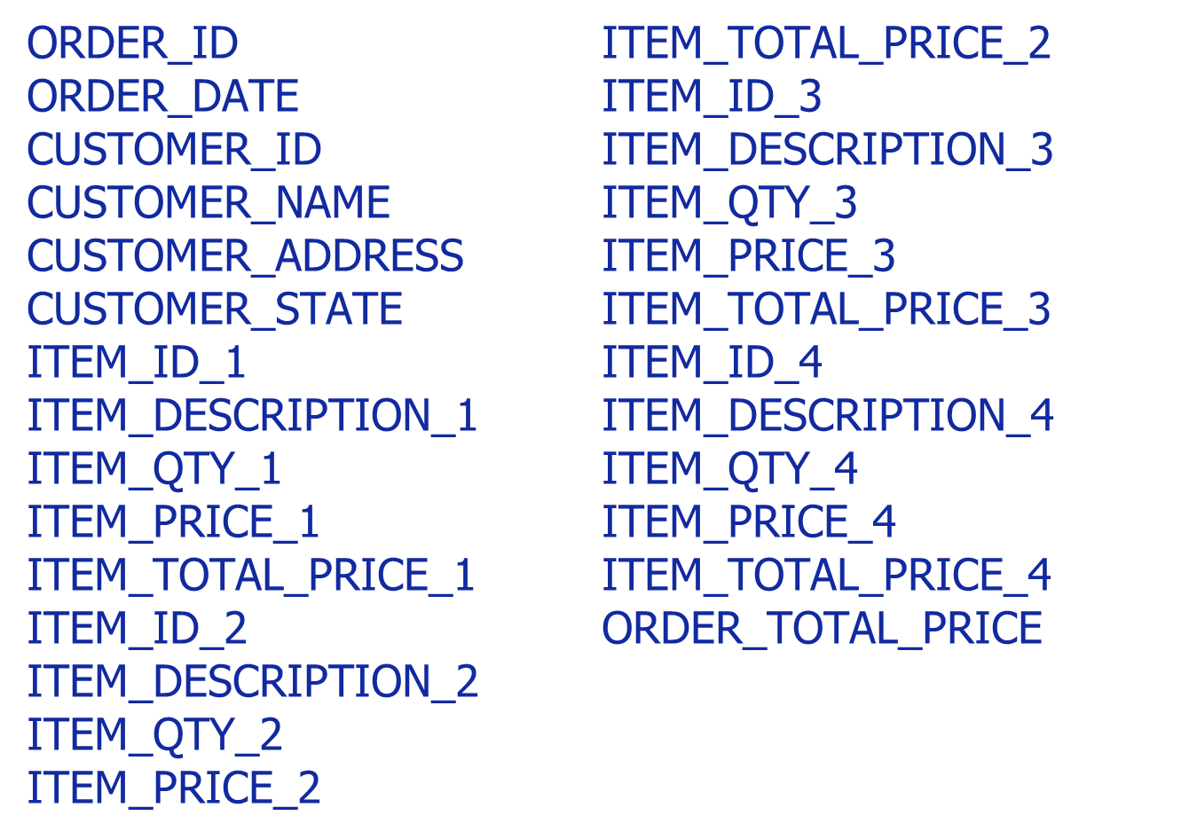
Case Study on Normalization – 1 of 5

Slide 45
Case Study on Normalization – 2 of 5
ORDERS
ORDER_ID – (PK)
ORDER_DATE
CUSTOMER_ID
CUSTOMER_NAME
CUSTOMER_ADDRESS
CUSTOMER_CITY
CUSTOMER_STATE
ITEM_ID – (PK)
ITEM_DESCRIPTION
ITEM_QTY
ITEM_PRICE
ITEM_TOTAL_PRICE
ORDER_TOTAL_PRICE
Data in First Normal Form:
NO Repeating Groups

Slide 46
Case Study on Normalization – 3 of 5
Data in Second Normal Form: Column’s dependency on only part of a Composite Key - Phase I
ORDERS
ORDER_ID – (PK)
ORDER_DATE
CUSTOMER_ID
CUSTOMER_NAME
CUSTOMER_ADDRESS
CUSTOMER_CITY
CUSTOMER_STATE
ORDER_ITEMS
ORDER_ID – (PK)
ITEM_ID - (PK)
ITEM_DESCRIPTION
ITEM_QTY
ITEM_PRICE

Slide 47
Case Study on Normalization – 4 of 5
Data in Second Normal Form: Column’s dependency on only part of a Composite Key - Phase II
ORDERS
ORDER_ID – (PK)
ORDER_DATE
CUSTOMER_ID
CUSTOMER_NAME
CUSTOMER_ADDRESS
CUSTOMER_CITY
CUSTOMER_STATE
ORDER_ITEMS
ORDER_ID – (PK)
ITEM_ID – (PK)
ITEM_QTY
ITEMS
ITEM_ID – (PK)
ITEM_DESCRIPTION
ITEM_PRICE

Slide 48
Case Study on Normalization – 5 of 5
Data in Third Normal Form: Non-Key Column’s representing a fact about another non-key Column. x
ORDERS
ORDER_ID – (PK)
CUSTOMER_ID – (FK)
ORDER_DATE
ORDER_ITEMS
ORDER_ID – (FK) | (PK)
ITEM_ID – (FK)
ITEM_QTY
CUSTOMER
CUSTOMER_ID – (PK)
CUSTOMER_NAME
CUSTOMER_ADDRESS
CUSTOMER_CITY
CUSTOMER_STATE
ITEMS
ITEM_ID – (PK)
ITEM_DESCRIPTION
ITEM_PRICE

